Slide 1
Raising Aspirations
Y9 Options Evening
Wednesday 29th January 2025
Please collect your option booklet

Slide 2

Exciting part of your THS journey
Refining your options for years 10 and 11
Where will these options take you?
Notes:
RAP- Exciting time- reinforce the importance of getting it right, we are here to support you to make this decision
Hand over to Kate

Slide 3
Digital
Hospitality and catering
Protective services
Legal, finance
and accounting
Care
services
Engineering and manufacture
Agriculture, environment & animal care
Creative and design
Business and administration
Sales, marketing and procurement
Hair and beauty
Early years and education
Construction and the built environment
Health and Science
Transport and logistics
Notes:
Introduce, animate the careers which come up one after the other
KG explains her role and stresses so many difference careers out there under the following heading, this is what we use to help students focus their interests and ideas

Slide 4
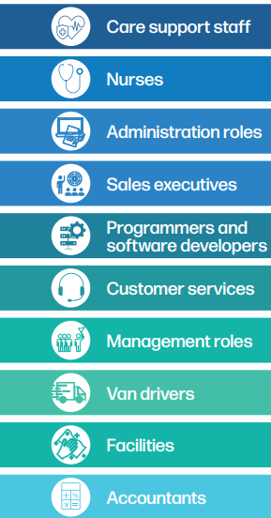

Labour Market
Most of the labour market careers are careers that need specialist training at a high level
Notes:
We must share region labour market information with parents about career opportunities and these jobs need specist training

Slide 5
Where will your options take you?
Navigating Journeys to Higher Education | Next Steps South West
Explore careers | National Careers Service
These websites can help you to:
  Understand the qualifications and experience you need for your chosen career
  Trace steps back from your goal to where you are now ie plan your route!
  Understand what opportunities and progression options within your career
Notes:
Kate to add website

Slide 6
Does it matter if I don’t know what I want to do?
Don’t worry, its ok!
Choose what you enjoy and what you are good at
Think about the skills that are transferable and develop them.
Notes:
Reinforce we are here to help

Slide 7





Colleges
Colleges
Notes:
Lucky to have so many options for 6th form colleges, mention, blundells, exeter maths school armed forces

Slide 8
What do you need to start thinking about?
What is your post-16 progression plan and what college do you want to attend?
What specific GSCE or vocational grades do you need for my future learning?
Be aware of how GCSE and vocational grades impact on career paths.
What career would you like to experience for you work placement in year 10?
Notes:
Think how your options will enable to continue, doctor? Preferable to do sep science

Slide 9
What about university?
Do you need a degree in your chosen area of study that will enable you to get the career of your dreams?
What specific GCSEs or vocational subjects do you need for University?

Slide 10
Understanding the next steps
Old GCSEs | New GCSE Grades | Vocational quals | Levels | What next
A* A | 9 | Distinction * Distinction Merit Pass | Level 2 | If you achieve these grades you go onto study a level 3 course
A* | 8 | Distinction
A | 7
B C | 6
C | 5
C | 4
D E F G | 3 | Distinction * Distinction Merit Pass | Level 1 | If you achieve these grades you go onto study a level 1 or level 2 course, depending on the course and your grades
E | 2
F/G | 1
U | U | U
If you do not achieve grade 4 at maths and English then you will have to retake these at college

Slide 11
A and AS levels
study at least three subjects
Exam assessment coursework/ practical assessment
Most require at least five grade 4+ at GCSE
grade 6 in the subjects you want to study
T Levels
Designed by
employers
universities
Three
months work
experience
building skills and knowledge
Leads to a specific occupation
BTEC
learning programmes relate to specific job roles/ sectors
progress in a career or go on to University
Designed by industry
Practical
Apprenticeships
You will have a contract of employment for 30 hours per week​
​
You earn a real wage of (from April 25 £7.55) per hour whilst gaining skills and qualifications​
​
Minimum requirements are English and maths GCSE​
Level 3 | A level and AS levels | L1- 3: T-Levels, BTECs, Cert. Diploma, OCR, City and Guilds |  | NVQ L3 | Advanced Apprenticeships
Level 2 | GCSE (Grades 4-9) |  | L1-2: Health & Social Care Sports Studies, Construction, Hospitality & Catering | NVQ L2 | Intermediate Apprenticeships
Level 1 | GCSE (Grades 1-3) |  |  | NVQ L1
Level 1 | GCSE (Grades 1-3)
Pathway: | Academic | Vocational |  | Work-based
Can study these courses at level 1 and 2

Slide 12
You will do 10 qualifications
How will my Y10 & Y 11 timetable be made up?

Slide 13
The Basics
English
Literature
GCSE
English
Language
GCSE
Maths
GCSE
All students need at least a grade 4 in English and Maths to progress onto courses at college.
If you do not achieve this then you will need to retake at college
Notes:
Stress the importance of 4s

Slide 14
Science
Science
Chemistry
GCSE
Combined science
GCSE
Combined science
GCSE
You will likely have to move populations to ensure you are in the right set
Biology
GCSE
Physics
GCSE
Combined science is biology, Chemistry and Physics worth 2 GCSEs and your grade will be shown as a 6/6
Separate science is worth 3 GCSEs you will get a grade for each individual science. This is hard, your timetable will be made up of 6 lessons a week of science. Study this if you want to study science A levels.

Slide 15
Ebacc option
The Ebacc
Students need to pick one of the following
You can pick more than one.
Separate science
Geography
History
French
German

Slide 16
The Open Basket: Pick 3
You can choose as separate GCSEs in Art & Photography or 3D art and photography but not Art and 3D design
Art GCSE Photography GCSE 3D Design GCSE
Design Technology GCSE or Construction
PE GCSE or Sports Studies
Music
Food, Preparation and Nutrition
History
Computer Science
Geography
Dance
French
Drama
Religious Studies
German
You can only study a GCSE if you have studied them in year 9

Slide 17
The new subject
Health and Social Care
If you want to choose Health and Social Care please, write a short sentence about why you want to study this subject.

Slide 18
Religion Studies lesson in year 10 and 11
Religious Studies in year 10 and 11
All students will have a Religious Studies lesson where students will study for a short course GCSE
You may want to take the full Religious studies GCSE. The short course which will also be studies will complement the full course.

Slide 19
PSHE Lesson
From February half term all students will have a PSHE lesson, this will no longer be in tutor time.
During these lessons students will be thinking about all aspects of life, including careers.
Development days will continue to offer experiences for students to work with employers, colleges and explore apprenticeship routes.
Assemblies will cover key dates and information about work experience and college opportunities.

Slide 20
PE Core
All students will have two core PE lessons a week until the end of year 11.

Slide 21
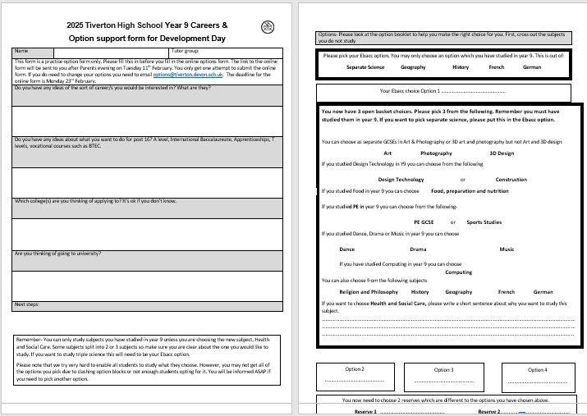
Deadline and process
This form in the back of the options booklet is a practice option form only.
Please fill this in before you fill in the online options form.
The link to the online form will be sent to you after Parents evening on Tuesday 11th February.
You only get one attempt to submit the online form.
If you do need to change your options, you need to email options@tiverton.devon.sch.uk.

Slide 22
Deadline and process
The deadline for the online form is Monday 24th February.
We will speak to students and parents if options choices are not running or there are issues with the options picked after the deadline.
We will do everything we can to give you your top four choices, but it may not be possible.
Please include 2 reserves.
You have two weeks in September of year 10 to trial your options, if you feel you have made a mistake and there is room to change, you may. After the two weeks have gone by then you cannot change.
Remember it may be necessary to swap populations

Slide 23
Tonight, you will have the opportunity to talk to Subject Leaders about the qualifications
Think about the breadth of subjects you could study
Think about the mix of exam-based subjects and controlled
Assessments
Ask about expectations of home learning
Think about attendance

Slide 24
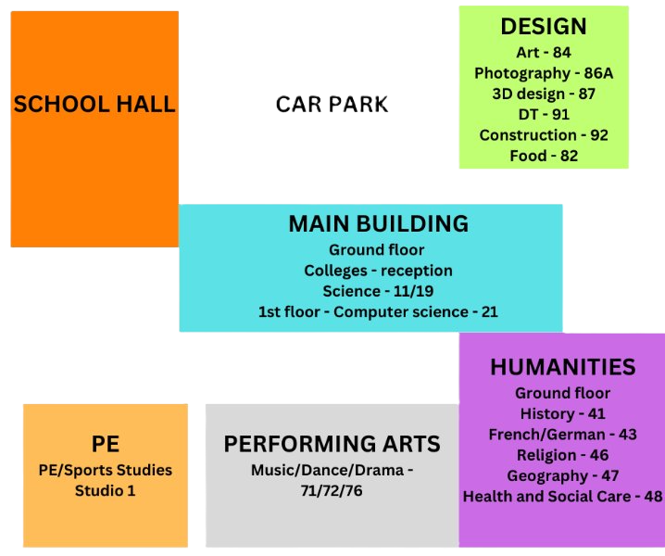
MAP

