Slide 1

Name:
Tutor Group:
Planning for a successful exam series
This journal is an opportunity to prepare for your exams and be successful by:
Checking your knowledge and skills, to understand best where to focus your revision and learning
Experience exam papers so you know what to expect
Plan to help you practice prioritising and managing work
Practice different revision techniques and strategies, so you know what works best for you
Have a set of accurate current grades, so that you can see the progress you are making
Only YOU can maximise the time and resources that you have now, to get the most out of your exams.
MAKE THE DAYS COUNT

Slide 2

To Achieve Success…
Revise
Complete independent work at home, attend all available revision sessions and complete homework.
BE ORGANISED
Plan carefully so you know what is happening when, what equipment you need, which topics to focus on.
To be as successful as possible in your PPEs and final exams, you need to…
FOCUS ON WHAT YOU DON’T KNOW
Focus your revision and learning on what you don’t yet know or aren’t fully confident with.
TRY YOUR BEST
Be committed and motivated, set yourself high standards and focus on achieving well.

Slide 3
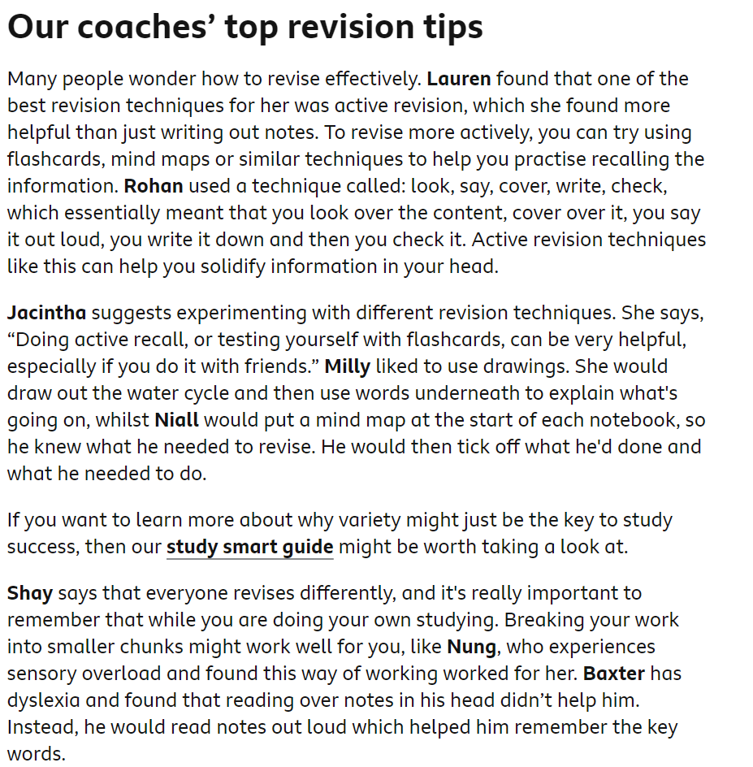
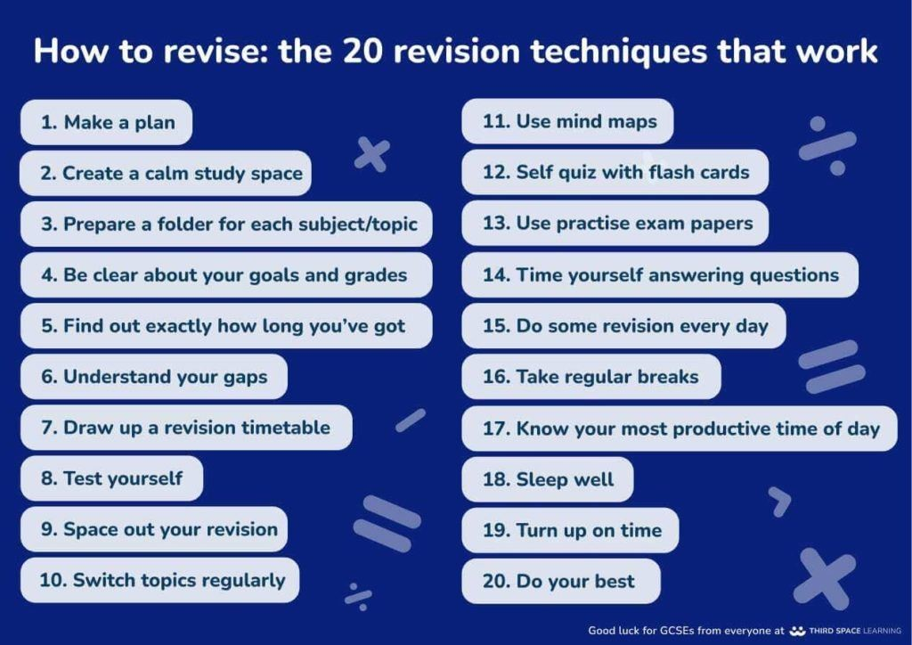
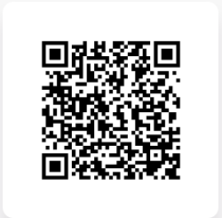
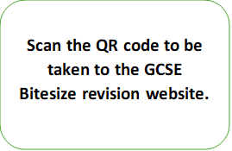
Revision Top Tips

Slide 4

Career Action Plan
What are my next steps?
What qualifications will I need?
What experience do I need?
Career Goal:

Slide 5
What grades do you want to achieve in your real exams? These should be ASPIRATIONAL!
SUBJECT | GRADE I AM AIMING FOR… | HOW CONFIDENT AM I (1 NOT, 5 SUPER)…
English Language
English Literature
Maths
Sciences (2 or 3 grades)
Option A:
Option B:
Option C:
Option D:
These grades should allow you to leave Tiverton High School and choose what you want to study next! The more aspirational you are, and the more progress you make, the more choices you will have.

Slide 6
Planning Your Week: Which intervention sessions are you attending?
 | Before school/Tutor time interventions (Subject/room) | Break | Lunch | After school
Monday
Tuesday
Wednesday
Thursday
Friday

Slide 7
October Mocks Timetable
Date | Exams periods 1 & 2 | Duration | Exams periods 3 & 4 | Duration
Tuesday 4 November | English Literature | 2hrs | Geography | 1hr 30 mins
Wednesday 5 November | Biology | Combined 1hr 15 mins Separate 1hr 45 mins | History | 2hrs
Thursday 6 November | Maths Non-calculator | 1hr 30 mins | RPS | 1hr 30 mins
Friday 7 November | Chemistry | Combined 1hr 15 mins Separate 1hr 45 mins | Construction D&T | 1hr 2hrs
Monday 10 November | Physics | Combined 1hr 15 mins Separate 1hr 45 mins | PE Dance | 1hr 30 mins 1hr 30 mins`
Tuesday 11 November | English Language | 1hr 45 mins | French Reading German Reading | 1hr 1hr
Wednesday 12 November | Maths Calculator | 1hr 30 mins | Food | 1hr 45 mins
Thursday 13 November | Computing Health & Social Care | 1hr 30 mins 1hr 15 mins | Drama | 1hr 45 mins

Slide 8
October Mocks Timetable​
Date | Exams periods 1 & 2 | Duration | Exams periods 3 & 4 | Duration
Monday 17 November | Art (11A) Room 84 Photography (11C) Room 86A | All Day All Day | Art (11A) Room 84 Photography (11C) Room 84A | All Day All Day
Tuesday 18 November | Art (11B) Room 84 3D Room 87 | All Day All Day | Art (11B) Room 84 3D Room 87 | All Day All Day
Wednesday 19 November | Art (11D) Room 87 Photography (11D) Room 86A | All Day All Day | Art (11D) Room 87 Photography (11D) Room 86A | All Day All Day
Thursday 20th November | German Speaking MFL Office | All Day | German Speaking MFL Office | All Day
Friday 21 November | French Speaking MFL Office | All Day | French Speaking MFL Office | All Day

Slide 9
 | Monday 22nd September | Tuesday 23rd September | Wednesday 24th September
5pm
6pm
7pm
8pm
9pm
 | Thursday 25th September | Friday 26th September
5pm
6pm
7pm
8pm
9pm
Revision Planner
Map out your time leading up to your exams. Focus on specifically what you revise, not just the subject or the paper.
5 weeks until first written exam.

Slide 10
Time | Saturday 27th September | Sunday 28th September
Weekends give you the time and space to revise when you find it best for you. Map out the times that you will dedicate to revision, around other commitments.

Slide 11
 | Monday 29th September | Tuesday 30th September | Wednesday 1st October
5pm
6pm
7pm
8pm
9pm
 | Thursday 2nd October | Friday 3rd October
5pm
6pm
7pm
8pm
9pm
Revision Planner
Map out your time leading up to your exams. Focus on specifically what you revise, not just the subject or the paper.
4 weeks until first written exam.

Slide 12
Time | Saturday 4th October | Sunday 5th October
Weekends give you the time and space to revise when you find it best for you. Map out the times that you will dedicate to revision, around other commitments.

Slide 13
 | Monday 6th October | Tuesday 7th October | Wednesday 8th October
5pm
6pm
7pm
8pm
9pm
 | Thursday 9th October | Friday 10th October
5pm
6pm
7pm
8pm
9pm
Revision Planner
3 weeks until the Easter break.
What is your plan for revision?

Slide 14
Time | Saturday 11th October | Sunday 12th October
Weekends give you the time and space to revise when you find it best for you. Map out the times that you will dedicate to revision, around other commitments.

Slide 15
 | Monday 13th October | Tuesday 14th October | Wednesday 15th October
5pm
6pm
7pm
8pm
9pm
 | Thursday 16th October | Friday 17th October
5pm
6pm
7pm
8pm
9pm
Revision Planner
Map out your time leading up to your exams. Focus on specifically what you revise, not just the subject or the paper.
2 Weeks until first written exam.

Slide 16
Time | Saturday 18th October | Sunday 19th October
Weekends give you the time and space to revise when you find it best for you. Map out the times that you will dedicate to revision, around other commitments.

Slide 17
 | Monday 20th October | Tuesday 21st October | Wednesday 22nd October
5pm
6pm
7pm
8pm
9pm
 | Thursday 23rd October | Friday 24th October
5pm
6pm
7pm
8pm
9pm
Revision Planner
Map out your time leading up to your exams. Focus on specifically what you revise, not just the subject or the paper.

Slide 18
Time | Saturday 25th October | Sunday 26th October
Weekends give you the time and space to revise when you find it best for you. Map out the times that you will dedicate to revision, around other commitments.

Slide 19
Time | Monday 27th October | Tuesday 28th October | Wednesday 29th October | Thursday 30th October | Friday 31st October
October Half Term is a crucial week to prepare for your Exams. You have had 5 weeks of focused study – this week is the time to consolidate what you have learnt, and prioritise what you don’t know. The week gives you the time and space to revise when you find it best for you. Map out the times that you will dedicate to revision, around other commitments.

Slide 20
Time | Saturday 1st November | Sunday 2nd November
Weekends give you the time and space to revise when you find it best for you. Map out the times that you will dedicate to revision, around other commitments.

Slide 21
 | Monday 3rd November | Tuesday 4th November | Wednesday 5th November
5pm
6pm
7pm
8pm
9pm
 | Thursday 6th November | Friday 7th November
5pm
6pm
7pm
8pm
9pm
Mock exams week 1

Slide 22
Time | Saturday 8th November | Sunday 9th November
Weekends give you the time and space to revise when you find it best for you. Map out the times that you will dedicate to revision, around other commitments.

Slide 23
 | Monday 10th November | Tuesday 11th November | Wednesday 12th November
5pm
6pm
7pm
8pm
9pm
 | Thursday 13th November | Friday 14th November
5pm
6pm
7pm
8pm
9pm
Mock exams week 2

